Slide 1

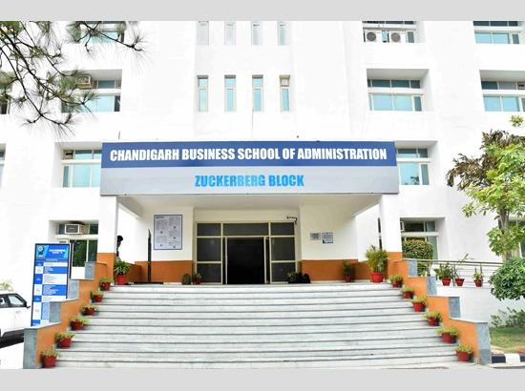

Slide 2
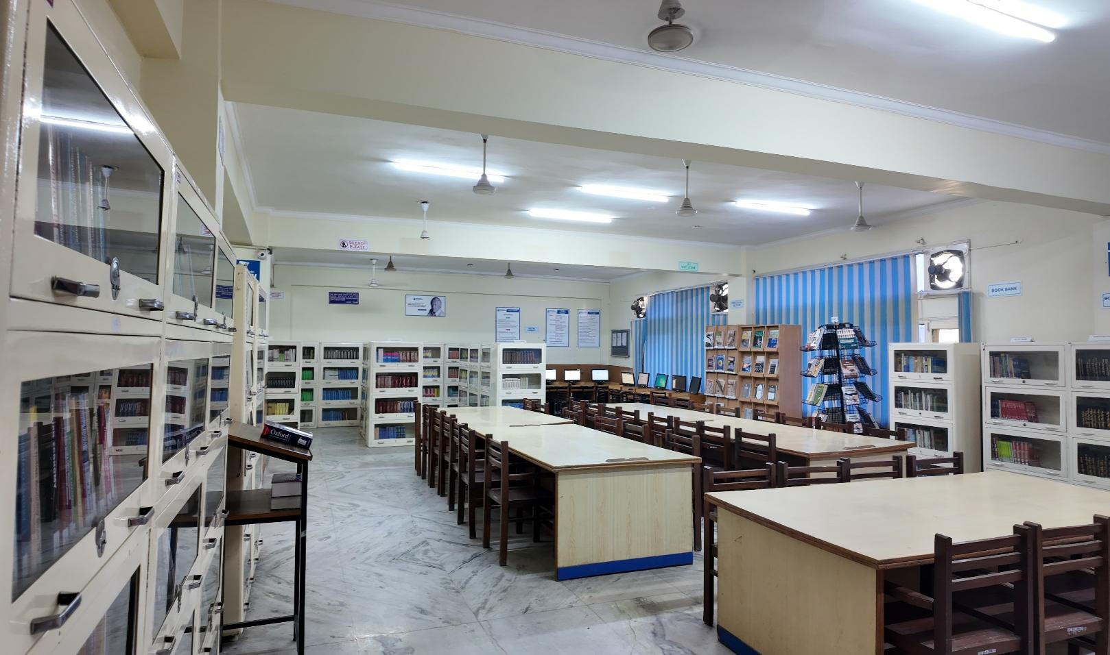
The online library provides live access to CHANDIGARH BUSINESS SCHOOL OF ADMINISTRATION LIBRARY Collection on institution website http://cbsmohali.org Students and Faculty can get online information about Books/CD’s/E Books/ Journals/ E journals dealing with various subjects. Library works on LIBSYS software. CBSA Library have 2 CCTV’s cameras to keep a close watch on the users so as to minimize the losses and mutilation of reading material.

Slide 3
MISSION
The College Libraries are to sustain a physically and virtually appealing environment that promotes learning, teaching and research. It fosters lifelong intellectual growth and self-fulfilment by providing all users with versatile accessibility of the needed information resources. It also stimulates to promote individual sharing of ideas and love of reading and social enlightenment, enrichment throughout the knowledge society. It also supports in excellence and innovation in education and research.

Slide 4
OBJECTIVES
1) To establish a readers’ community to strengthen the goals.
2)To organize orientation programmes for users to keep them aware of the information society.
3) To promote the values and skills amongst the students.
4)To maintain a balanced and organized collection of high-quality materials and provide professional assistance to all users.
5) To provide access to information located elsewhere.
6)To educate users in developing information-gathering skills, including accessing, evaluating, and using various information sources.
7)To promote technological competence by providing access to information available in non-print formats.

Slide 5
COLLEGE WEBSITE http://cbsmohali.org/
LIBRARY SOFTWARE
LIBSYS

Slide 6

LIBRARY TIMINGS
9 am
to
4:30 pm

Slide 7
LIBRARY AT A GLANCE
ITEM QTY
TOTAL COLLECTION | 21924
NO. OF TITLES | 3641
REFERENCE & GENERAL BOOKS | 4212
RARE BOOKS | 104
BOOK BANK | 249
PRINT JOURNALS | 33
BOUND VOLS. OF PREVIOUS YEARS | 509
NEWSPAPERS | 5
MAGAZINES | 8

Slide 8
CBSA LIBRARIES
TOTAL MEMBERSHIP
2500
DAILY FOOTFALL
100
DAILY TRANSACTIONS
100

Slide 9
CBSA LIBRARY STAFF
NAME | DESIGNATION
RENU OBEROI | CHIEF LIBRARIAN
SITAL PRASAD | LIBRARIAN
PAWAN KUMAR | LIBRARY ASSISTANT
PRITPAL SINGH | LIBRARY RESTORER
NANDINI | LIBRARY RESTORER

Slide 10
LIBRARY COMMITTEE
NAME | DESIGNATION
DR. RAMANDEEP SAINI (DIRECTOR -PRINCIPAL) | CHAIRMAN
MRS. RENU OBEROI (CHIEF LIBRARIAN) | MEMBER SECRETARY
DR. RAKHI DEWAN (HOD-MBA) | MEMBER
DR. CHHINDER KAUR DHALIWAL (HOD-DCA) | MEMBER
DR. PREETI SHARMA (HOD-BBA) | MEMBER
DR. SEEMA RANI (HOD-COMMERCE) | MEMBER
DR. BALJINDER KAUR (PROFESSOR) | MEMBER

Slide 11
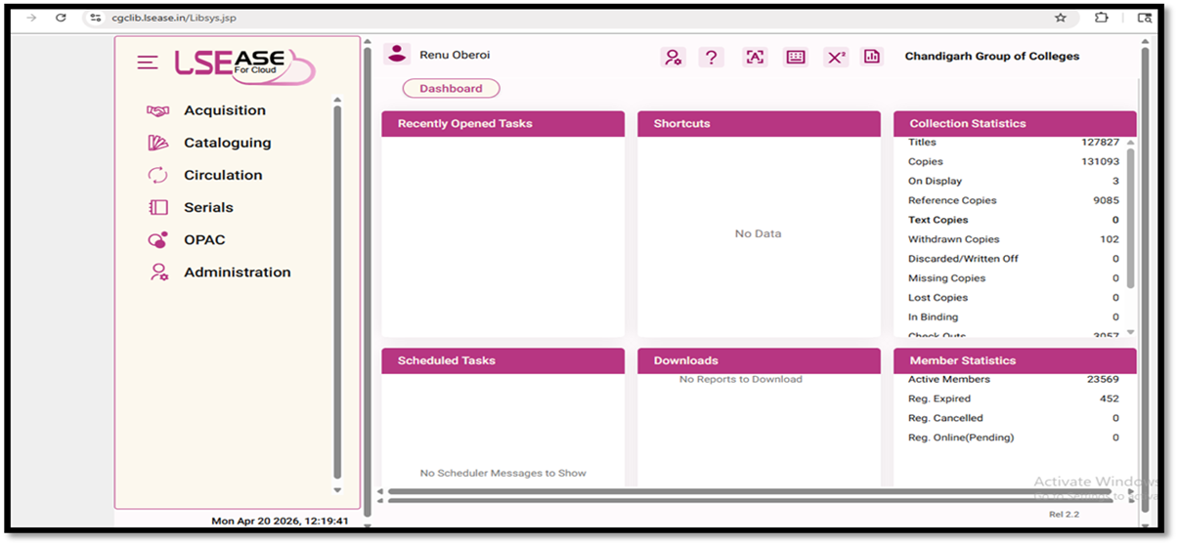
LIBRARY AUTOMATION USING INTEGRATED LIBRARY MANAGEMENT SYSTEM (ILMS)
LIBRARY SOFTWARE INTERFACE
Works on Cloud
URL : http://cgclib.lsease.in/
WEBOPAC with Remote Access
URL : http://cgcopac.lsease.in/

Slide 12
LOCATE YOUR BOOK(S)
“HOW TO USE WEB OPAC”
STEP 1 : SEARCH ON CGC WEBSITES:- www.cgc.edu.in OR cbsmohali.org .
STEP 2 : CLICK ON ONLINE LIBRARY OR LIBRARY.
STEP 3 : IN THE SEARCH BAR :
SEARCH BY AUTHOR (SURNAME/FIRST NAME)
SEARCH BY TITLE (DON’T USE A, AN, THE)
SEARCH BY KEYWORD
STEP 4 : SELECT THE BOOK OF YOUR CHOICE FROM YOUR CONCERNED LIBRARY ON
THE RIGHT-HAND SIDE FIELD (i.e., ALL) AND “GO”.
STEP 5 : SELECT BROWSE: TO KNOW ABOUT COLLECTION BY AUTHOR, TITLE,
CLASSIFIED, SUBJECT, PUBLISHER, PLACE.
STEP 6 : SELECT MY ACCOUNT: TO KNOW ABOUT THE BOOKS YOU HAVE
FACULTY WILL ENTER EMPLOYEE CODE AS USER ID & STUDENTS WILL
ENTER ROLL NO. AS USER ID.
PASSWORD IS SAME FOR ALL “cgclib”.
AFTER LOGGING IN EVERYONE HAS THE OPTION TO CHANGE THEIR
PASSWORD.
NOTE : DO NOT CLOSE THE WINDOW AFTER USE

Slide 13


Slide 14

E RESOURCES
Number of e-books (WORLD E-BOOK LIBRARY) 20 Lacs+
Number of e-books (EBSCO) 2,65,000
NDL Membership E-BOOKs 45 Lacs+
Number of e-journals(DELNET) 778
Total Number of e-journals(EBSCO) 1538
EBSCO Business Elite 1056
NPTEL VIDEO LECTURES 11977
CDs ( of Books and Magazines) 693
TURNITIN Plagiarism Software

Slide 15

The library has subscription of DELNET database via link http://www.delnet.in since the year 2018 and is subscribing 778 e-journals and e-books through World e-book library via link http://database.worldlibrary.org/

Slide 16
EBSCO’S Business Source Elite
Journals indexed in WOS (approx.) | Journals indexed in Scopus (approx.) |  | Indexed in ABDC Journal Quality List (approx.)
225 | 282 |  | 212
Journals and Magazines |  | 1056 full text journals
Case studies |  | More than 900
Company Profiles |  | More than 15,000
Videos |  | Nearly 75,000 videos from Associated Press
Market Research Reports |  | 2400
Regional Business News |  | 80 regional business publications are covered in Regional Business News
Industry Reports |  | 8700
SWOT Analyses |  | More than 5000 SWOT analyses are indexed where only metadata is available
Financial Reports |  | 42
Conference Proceedings & Conference Papers |  | 150

Slide 17

EBSCO DATABASE
EBSCO resources can also be remotely accessed on EBSCO App. or on the link http://search.ebscohost.com.
It provides scholarly 1538 e-journals, working papers, reports, and datasets, and millions of digitized historical primary sources, including 2,65,000 e-books.

Slide 18

ANTI-PLAGIARISM SOFTWARE
To promote and support the research activities, CGC as a remedial measure has provided access to anti-plagiarism software TURNITIN since 2020.It is one such software, which is being successfully used at the global level to cross-check a vast database for identifying plagiarized portions in one’s research.

Slide 19

Lakhs of e-books can be accessed through NDL via link http://ndl.iitkgp.ac.in//.
INSTITUTIONAL NDL MEMBERSHIP NUMBER :INPBNC3ADJJC9BP

Slide 20

NPTEL Video lectures
Streamwise NPTEL
11977 video lectures can be accessed via website https://archive.nptel.ac.in/

Slide 21
E-RESOURCES : LOGIN CREDENTIALS WITH REMOTE ACCESS
DELNET : http://www.delnet.in
Click to New Discovery Portal
Login : pbcbsam
Password : cbs9468
2. World Library Access : http://database.worldlibrary.org/
Login:in_cgclm@user
Password: reading
3. EBSCO Business Source Elite : https://search.ebscohost.com/login.aspx?authtype=ip,uid&custid=ns154387&groupid=main&profile=ehost&defaultdb=bsh
User ID: chandigarhbusi
Password: Library@2025
4. EBSCO DATABASE : http://search.ebscohost.com
Login ID cgcl
Password clg@2025
5. EBSCO EBOOKS ; https://assets.ebsco.com/m/2914c90c85e2c31b/original/EBSCO-eBooks-Academic-Collection-Title-List-Worldwide.xlsx
6. NPTEL Video Lectures : https://archive.nptel.ac.in/
7. National Digital Library : https://ndl.iitkgp.ac.in/
8. TURNITIN PLAGIARISM SOFTWARE
9. LIBSYS WEBOPAC : https://cgcopac.lsease.in

Slide 22

Repository Links
1 e-PG Pathshala https://epgp.inflibnet.ac.in
2 e-Shodh Sindhu https://ess.inflibnet.ac.in
3 Search Engine for PDF Books www.pdfdrive.com
4 National Digital Library of India https://ndl.iitkgp.ac.in
5 ShodhGanga https://shodhganga.inflibnet.ac.in/
6 Discover scientific knowledge and stay connected to the world of science https://www.researchgate.net/
7 Free e books(60000+) https://www.gutenberg.org/
8 NPTEL [National Programme on Technology Enhanced Learning] https://nptel.ac.in
9 NPTEL Video Lectures https://archive.nptel.ac.in/

Slide 23
10 OASIS (Openly Available Sources Integrated Search) https://openlibrary.org/
11 Open access for academic books https://www.oapen.org/
12 SAKSHAT https://sakshat.ac.in/?project=vidwan
13 Open Access books https://www.doabooks.org/
14 SWAYAMPRABHA https://www.swayamprabha.gov.in
15 SWAYAM Online Courses https://storage.googleapis.com/uniquecourses/online.html
16 Enhancement in Learning with Improvement in Skills (ELIS) portal http://free.aicte-india.org/
17 DOAB - Directory of Open Access Books https://directory.doabooks.org/handle/20.500.12854/34495

Slide 24
18 DOAJ https://doaj.org/
19 e-Content courseware in UG subjects http://cec.nic.in/cec/
20 E-Kalpa https://icar.org.in/content/e-kalpa
21 Open Access Books and Journals https://about.jstor.org/librarians/books/open-access-books-jstor/
22 Free e-Books https://www.gutenberg.org/
23 AICTE Collaborations (MoU) with other Organizations https://www.aicte-india.org/education/collaborations
24 AAKASH EDUCATIONAL PORTAL https://www.it.iitb.ac.in/nmeict/home.html
25 InfoPort https:/infoport.inflibnet.ac.in
26 OAPEN https://www.oapen.org/

Slide 25
27 QUANTUM & NANO COMPUTING https://www.dei.ac.in/dei/quantumNano/
28 The Online Books Page https://onlinebooks.library.upenn.edu/lists.html
29 SNLTR https://nltr.org
30 EThOS https://ethos.bl.uk/Home.do
31 DART-Europe E-theses Portal https://www.dart-europe.org/basic-search.php
32 Virtual Labs http://www.vlab.co.in/
33 YOUTH4WORK https://www.youth4work.com/onlinetalenttest
34 Theses https://library-archives.canada.ca/eng
35 Gateway Accelerating Scientific Discovery https://worldwidescience.org/
36 DIGITAL LIBRARY INFLIBNET https://ess.inflibnet.ac.in/

Slide 26
37 Digital Commons Network https://irsc.libguides.com
38 Engineering Journal Database researchgate.net
39 FOSSEE https://fossee.in
40 Study IQ Education www.youtube.com
41 UG/PG MOOCs http://ugcmoocs.intlibnet.ac.in/ugemoocs
42 E-Books and E-Journals https://www.socsccybraryamu.ac.in/
43 CEC-UGC YouTube Channel https://www.youtube.com/user/cecedusat
44 TCS iON Digital Glass Room https://learning.tcsionhub.in/hub/glass-room/
45 RIC https://eric.ed.gov/
46 Free e-Databases http://www.globethics.net/

Slide 27

47 Free Journals http://www.archive.org
48 Spoken Tutorial https:/spoken-tutorial.org/
49 National Apprenticeship Training Scheme http://mhrdnats.gov.in/
50 E – Kumbh https://ekumbh.aicte-india.org/
51 E-BOOKS https://www.wikibooks.org/
52 Social Science Research Network (SSRN) https://www.ssrn.com/

Slide 28

e-Newspaper WEBSITES
http://www.tribuneindia.com
www.indianpress.org
www.hindustantimes.com
www.epaper.timesofindia.com
https://dailypost.in/#google_vignette
https://epaper.jagbani.com/
http://economictimes.indiatimes.com
http://epaper.amarujala.com
https://epaper.jagran.com/epaper/
http://epaper.punjabkesari.in
http://jagbani.epapr.in
http://epaper.ajitjalandhar.com
http://www.rozanaspokesman.com/epaper/

Slide 29

FREE access - E-MAGAZINE WEBSITES https://worldmags.net/ https://fliphtml5.com/ https://www.bisinfotech.com/bisinfotech-magazine https://pdf-magazines.org/ https://all-freemagazines.com/ https://downmagaz.net/ https://www.pdfmagaz.club/ https://magazinenewsstand.com/digital-magazines https://pdf-magazines-download.com/ https://openthemagazine.com/

Slide 31

FACILITIES PROVIDED BY LIBRARY

Slide 32
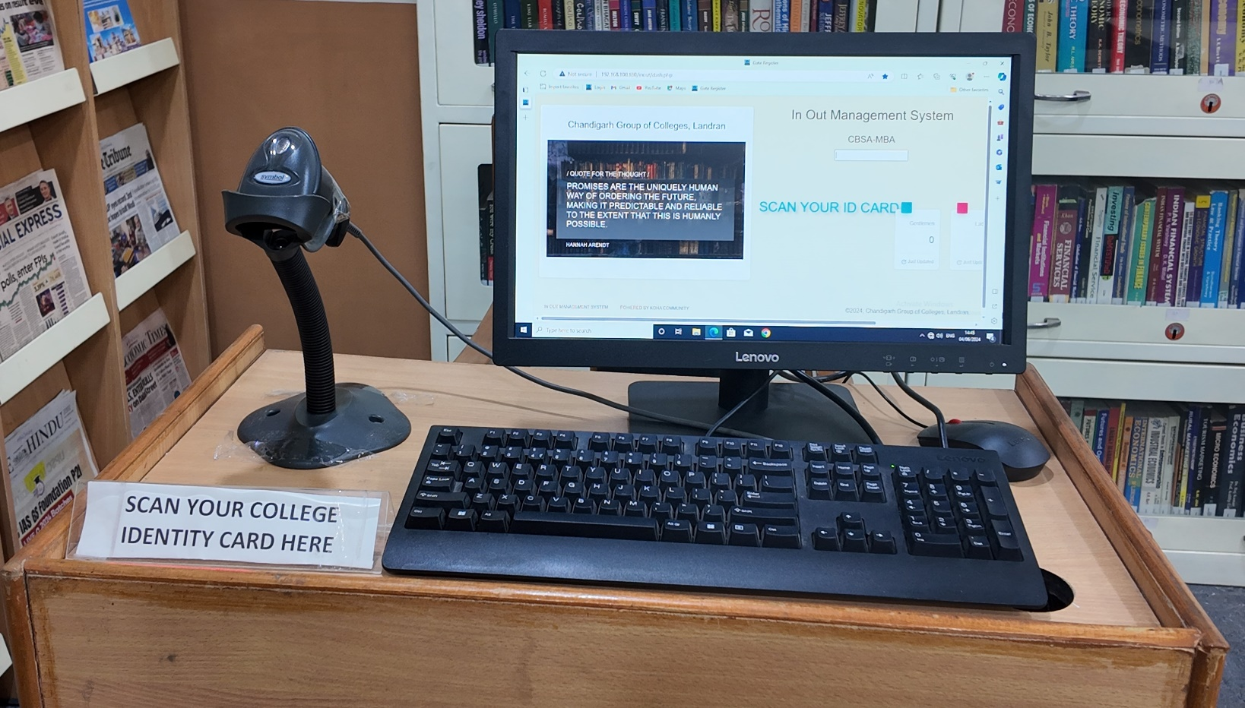
BARCODE SCANNED ENTRY/EXIT
Since the ID cards are scanned to keep track of entry and exit, foot traffic in the library is computerized. Students scan their ID cards as they enter or leave the library using the one barcode scanner.

Slide 33
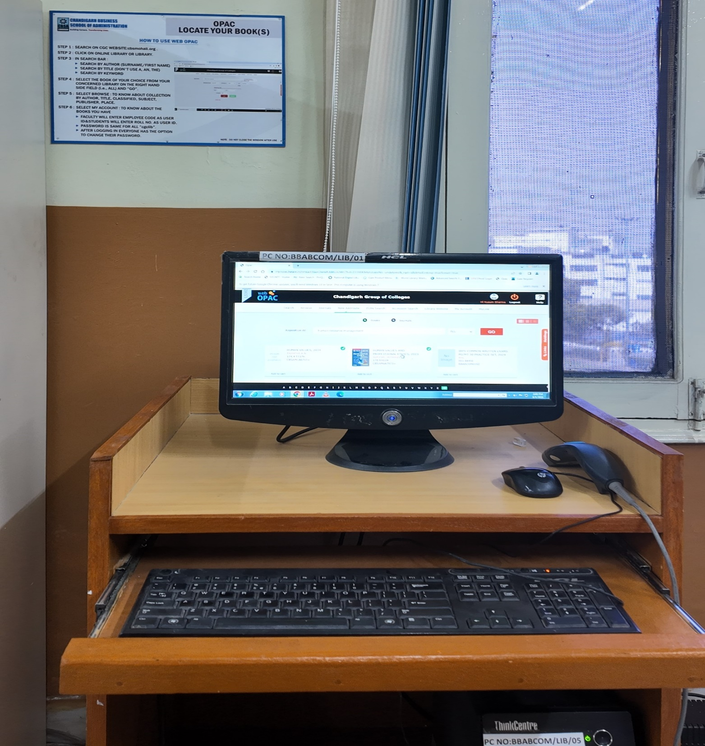
ONLINE CATALOGUE (OPAC)
The facility to search the open public access catalogue (OPAC) is open to all the users over the campus-wide LAN at the URL: https://cgcopac.lsease.in/. 1 pc in library is exclusively dedicated to OPAC search to facilitate the users.

Slide 34
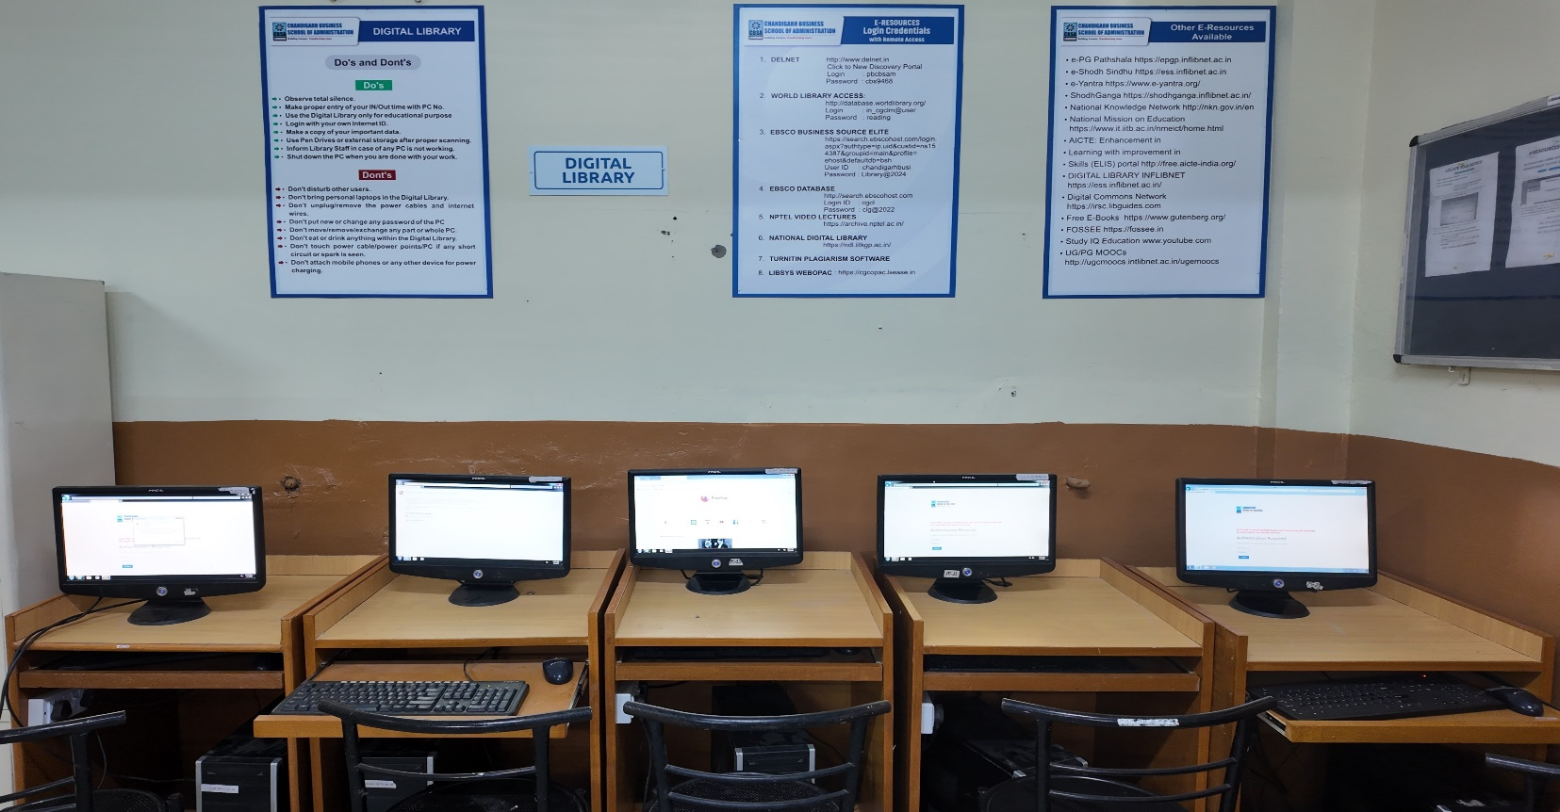
DIGITAL LIBRARY
THE LIBRARY INTENDS TO HAVE A WELL-DEVELOPED COMPUTER AND NETWORK INFRASTRUCTURE IN THE FORM OF A DIGITAL LIBRARY WITH A PROVISION OF 10 COMPUTERS IN TWO LIBRARIES TO FACILITATE THE USE OF ALL THE WEB-BASED RESOURCES AND SERVICES SUBSCRIBED

Slide 35
WI-FI FACILITY
STUDENTS & FACULTY CAN ACCESS THE INTERNET WITHIN LIBRARY PREMISES ON THEIR LAPTOPS AND MOBILES, AS THE LIBRARIES ARE WI-FI ENABLED.

Slide 36
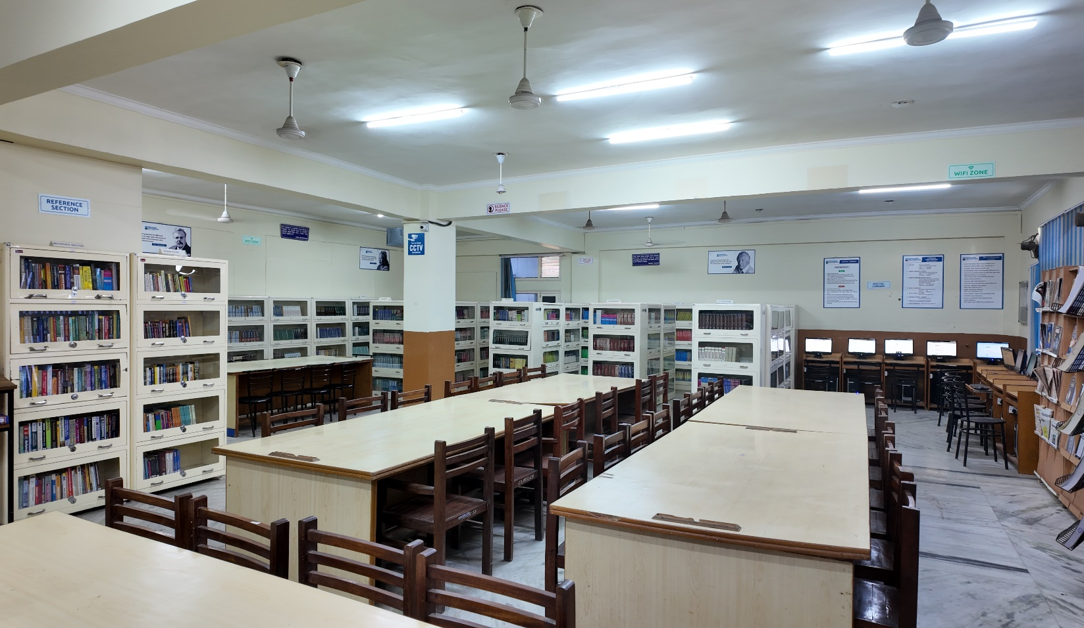
READING HALL FACILITY
The libraries provide its users with a conducive atmosphere with ample seating capacity.

Slide 37
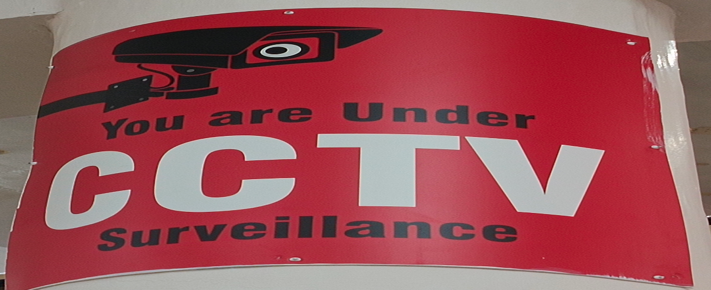
CCTVs in CBSA Library
2 CCTVs are installed in CBSA Library for 24hr. Surveillance

Slide 38
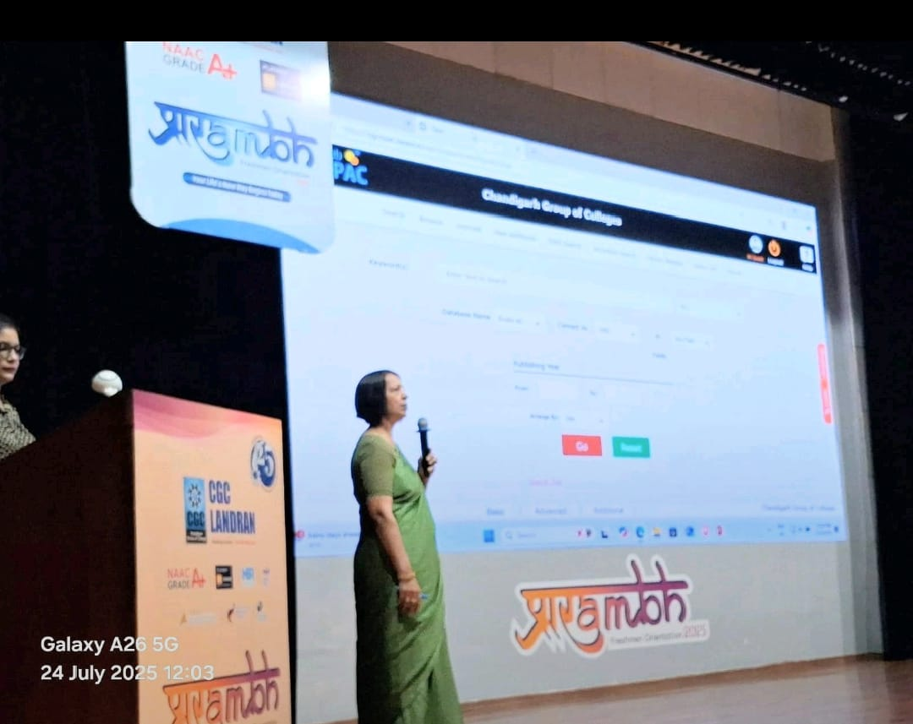
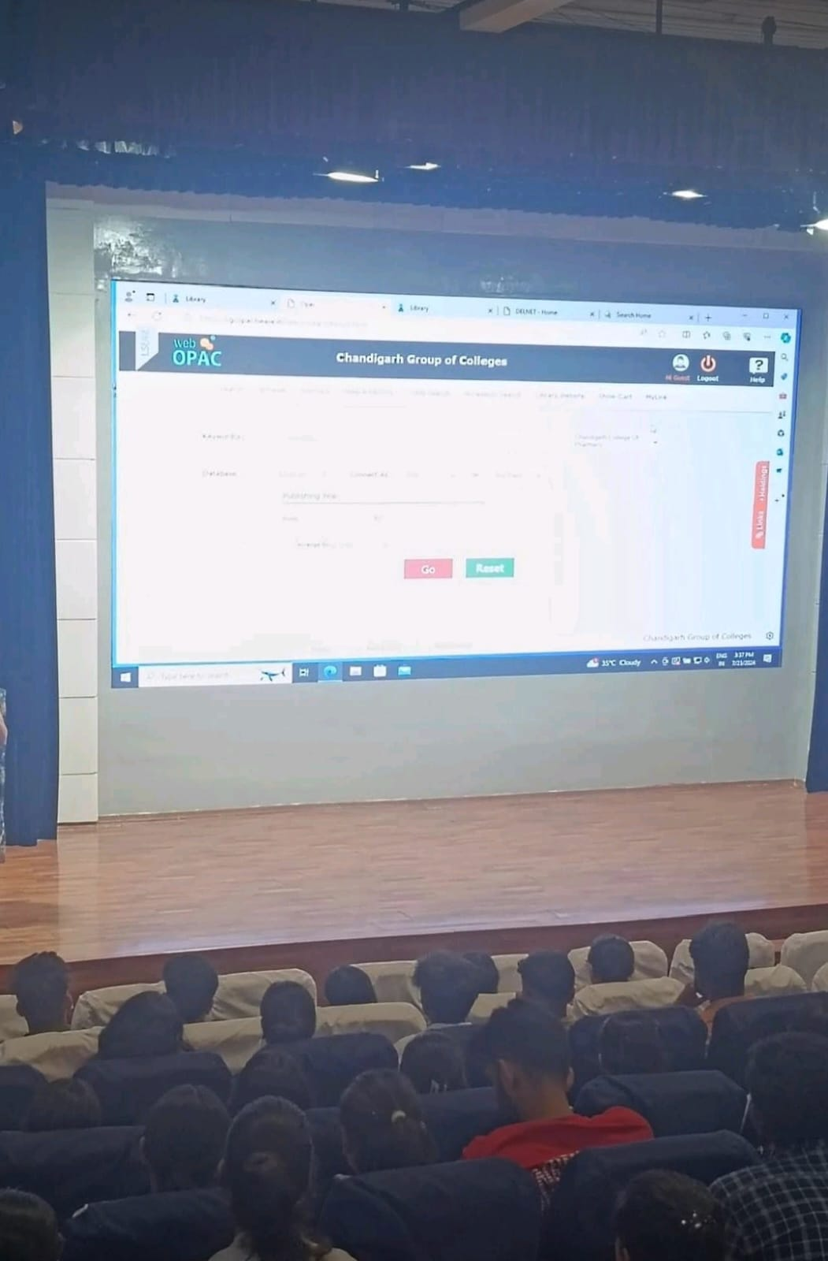
INDUCTION PROGRAMME FOR FRESHERS (SESSION 2025-26)

Slide 39
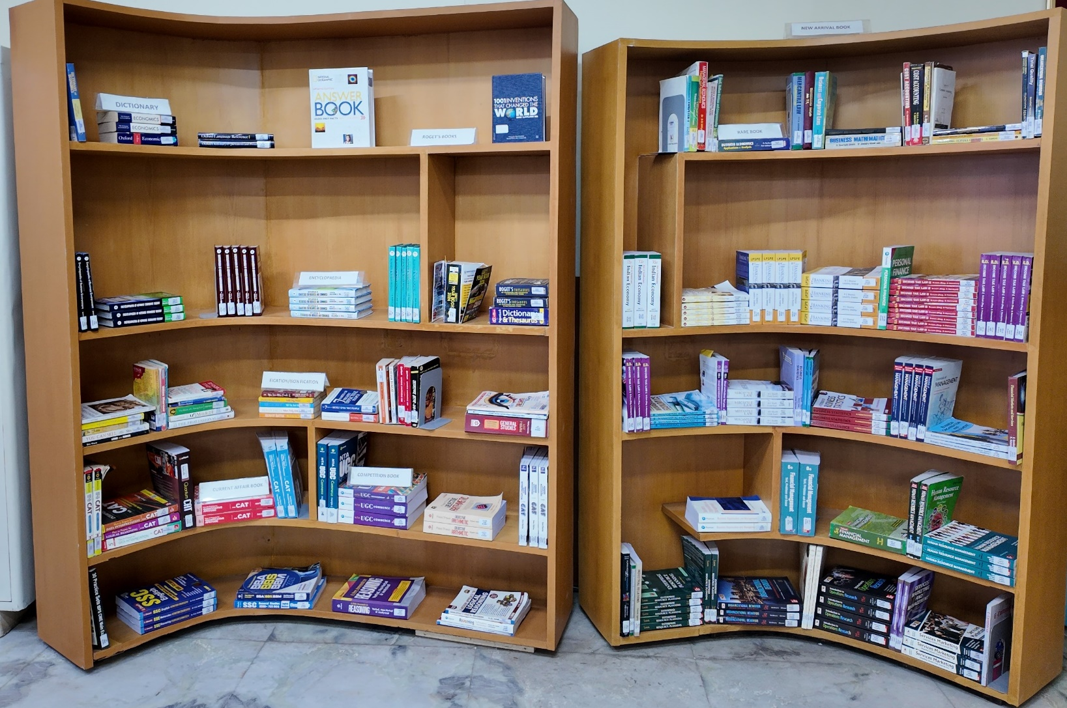
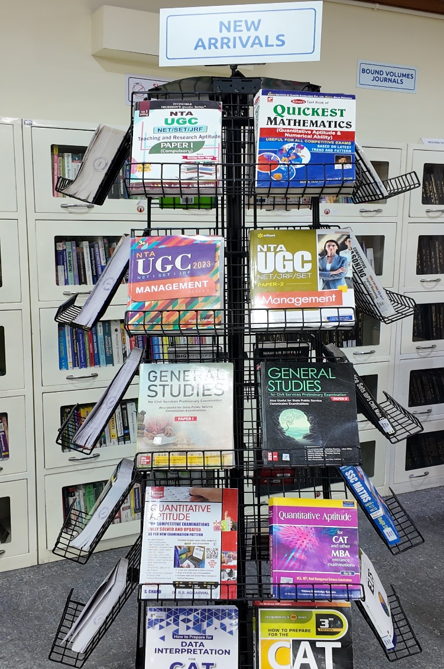
DISPLAY OF NEW ARRIVALS

Slide 40
NEW ARRIVALS
ACC. NO. | TITLE | AUTHOR | COPIES
MB8145-MB8149 | ORGANIZATION DEVELOPMENT AND CHANGE | CUMMINGS, THOMAS G. AND WORLEY, CHRISTOPHER G. | 5
MB8150-MB8153 | CORPORATE FINANCE | ROSS, STEPHEN A. [ET AL] | 4
MC6960-MC6961 | INFORMATION SECURITY AND CYBER LAWS | GUPTA, SARIKA AND GUPTA, GAURAV | 2
MC6962-MC6964 | DESIGN AND ANALYSIS OF ALGORITHMS: AN INDIAN ADAPTATION | GOODRICH, MICHAEL T. AND TAMASSIA, ROBERTO | 3
MC6965-MC6966 | MACHINE LEARNING USING PYTHON | PRADHAN, MANARANJAN & KUMAR, U. DINESH | 2
MC6967-MC6968 | DATA STRUCTURES AND ALGORITHNS IMPLEMENTATION THROUGH C | BAKARIYA, BRIJESH | 2
MC6969-MC6970 | COMPUTER FORENSICS: COMPUTER CRIME SCENE INVESTIGATION | BAKARIYA, BRIJESH | 2
MC6971-MC6972 | CRYPTOGRAPHY AND NETWORK SECURITY | KAHATE, ATUL | 2
MC6973-MC6974 | OBJECT-ORIENTED PROGRAMMING WITH C++ | BALAGURUSAMY, E. | 2

Slide 41
MC6975 | DOING DATA SCIENCE: STRAIGHT TALK FROM THE FRONTLINE | SCHUTT, RACHEL & O'NEIL, CATHY | 1
MC6976 | INTRODUCTION TO MACHINE LEARNING WITH PYTHON: A GUIDE FOR DATA SCIENTISTS | MULLER, ANDREAS C. AND GUIDO, SARAH | 1
BC6773-BC6782 | SECURITY ANALYSIS AND PORTFOLIO MANAGEMENT | KEVIN, S. | 10
BC6783 | INDIAN POLITY: FOR CIVIL SERVICES AND STATE SERVICES EXAMINATIONS | LAXMIKANTH, M. | 1
BC6784-BC6786 | ESSENTIALS OF BUSINESS ENVIRONMENT | ASWATHAPPA, K. AND RAMAN, LALITHA | 3
BC6787-BC6788 | ZERO TO ONE | THIEL. PETER WITH BLAKE MASTERS | 2
BC6789-BC6790 | MACROECONOMICS: THEORY AND POLICY | AHUJA, H.L. AND SINGH, DIGVIJAY | 2
BC6791-BC6795 | PRACTICAL APPROACH TO DIRECT AND INDIRECT TAXES | AHUJA, GIRISH AND GUPTA RAVI | 5

Slide 42

DIFFERENT SECTIONS OF LIBRARY
ENTRY/EXIT GATE
PROPERTY COUNTER
WEBOPAC SECTION
ACQUISITION SECTION
TECHNICAL SECTION
REFERENCE SECTION
CIRCULATION SECTION
PERIODICAL SECTION
BOUND VOLUMES SECTION
BOOK BANK SECTION
DIGITAL LIBRARY SECTION
REPROGRAPHIC SECTION

Slide 43
FOOTFALL
SR NO. | YEAR | TOTAL |  |  | TOTAL |  |  | GRAND TOTAL
 |  | MORNING TIMINGS |  |  | EXTENDED TIMINGS
 |  | MBA | DCA | BBA/BCOM/MCOM | MBA | DCA | BBA/BCOM/MCOM
1 | 2021 TO 2022 | 3510 | 2552 | 3983 | 980 | 1121 | 2032 | 14178
2 | 2022 TO 2023 | 10660 | 9223 | 9134 | 1689 | 2048 | 2942 | 35696
3 | 2023 TO 2024 | 13097 | 10207 | 9123 | 798 | 1602 | 586 | 35413
4 | 2024 TO 2025 | 8650 | 9864 | 8926 | 1451 | 1941 | 1790 | 34822
5 | 2025 TO 2026 | 8534 | 8546 | 7913 | 1069 | 1119 | 1001 | 32992

Slide 44
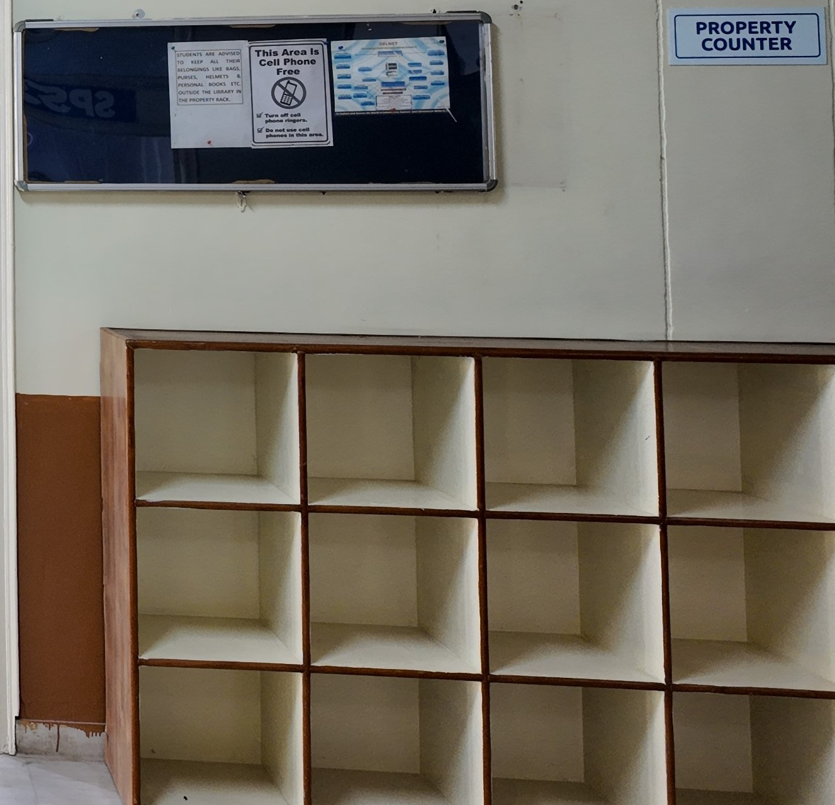
PROPERTY COUNTER

Slide 45
WEB OPAC

Slide 46
ACQUISITION SECTION
TITLES/VOLUMES ADDED IN 2021-2026
SESSION | COURSE | ACCESSION NUMBER | TOTAL NO. OF TITLES | TOTAL NO. OF VOLUMES | EXPENDITURE (RS.)
2025-2026 (Rs. 1,02,286) | MBA | 8099-8153 | 12 | 55 | 54129.00
 | MCA | 6950-6976 | 14 | 27 | 17787.00
 | BBA, B.COM | 6748-6795 | 20 | 48 | 30370.00
2024-2025 (Rs. 1,95,789) | MBA | 7987-8098 | 33 | 112 | 76499.00
 | MCA | 6873-6949 | 24 | 77 | 88784.00
 | BBA, B.COM | 6698-6747 | 14 | 50 | 30506.00
2023-2024 (Rs. 5,36,531) | MBA | 7857-7986 | 75 | 126 | 90146.00
 | MCA | 6503-6872 | 130 | 370 | 348052.00
 | BBA, B.COM | 6534-6697 | 52 | 164 | 98153.00
2022-2023 (Rs. 1,46,453) | MBA | 7671-7856 | 63 | 186 | 95721.00
 | MCA | 6465-6502 | 9 | 38 | 23935.00
 | BBA, B.COM | 6471-6533 | 8 | 63 | 26803.00
2021-2022 (Rs. 74,974) | MBA | 7606-7670 | 11 | 65 | 4982.00
 | MCA | 6408-6464 | 30 | 57 | 46161.00
 | BBA, B.COM | 6411-6470 | 9 | 60 | 23831.00
 |  |  | 504 | 1498 | 1055859.00

Slide 47
NO. OF TITLES WEEDED OUT /MISSING/PRICE PAID
YEAR | MBA | DCA | BBA/B.COM | STATUS | NO.
2013 | 0 | 20 | 0 | MISSING | 20
2014 | 116 | 193 | 0 | WEEDED OUT | 309
2016 | 127 | 0 | 0 | WEEDED OUT | 127
2023 | 22 | 31 | 30 | MISSING | 83
2025 | 18 | 28 | 11 | MISSING | 57
2008 TO 2026 | 34 | 18 | 79 | PRICE PAID | 131

Slide 48
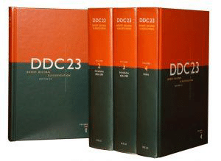
TECHNICAL SECTION
FOR INFORMATION STORAGE & RETRIEVAL, PROPER CLASSIFICATION & CATALOGUING OF EACH DOCUMENT IS DONE. LIBRARY IS USING DEWEY DECIMAL CLASSIFICATION (DDC) FOR CLASSIFICATION OF ITS DOCUMENTS

Slide 49
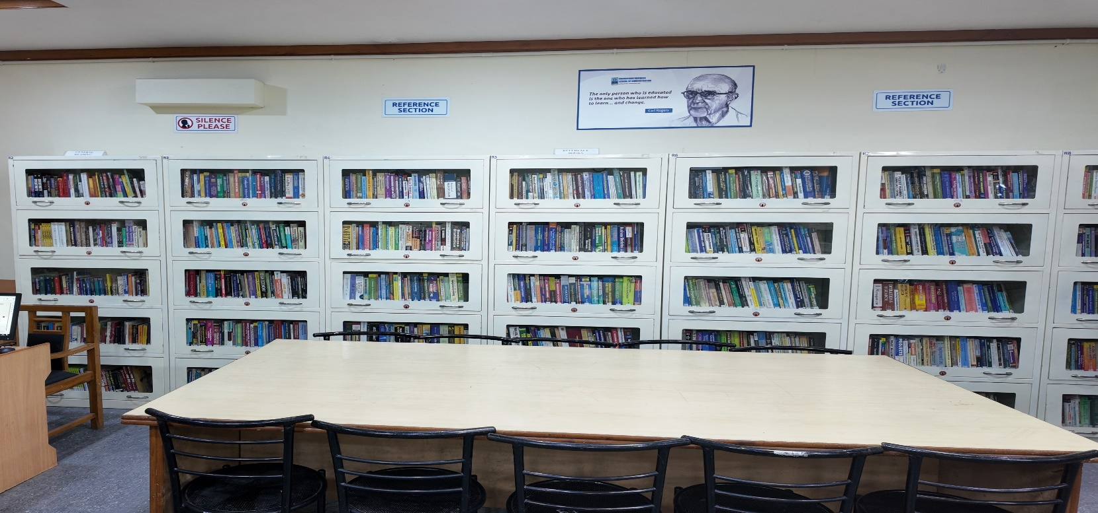
REFERENCE SECTION

Slide 50
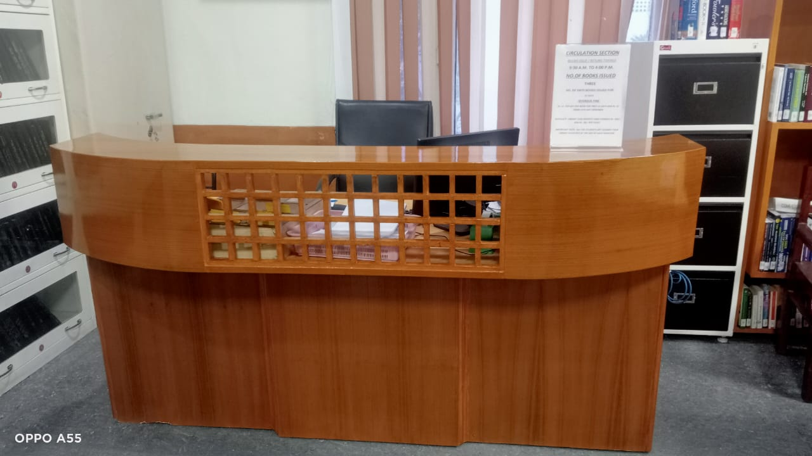
CIRCULATION SECTION

Slide 51
CIRCULATION SCHEDULE
NUMBER OF BOOKS ISSUED TO EACH STUDENT 3 BOOKS
PERIOD OF RETENTION 21 DAYS
MERITORIOUS/SC STUDENTS GET 2 BOOKS EXTRA
CIRCULATION TIMINGS
9:30 am to 4:00 pm
IMPORTANT: ALL THE STUDENTS GET CLEARED THEIR LIBRARY ACCOUNTS AT THE END OF EACH SEMESTER

Slide 52
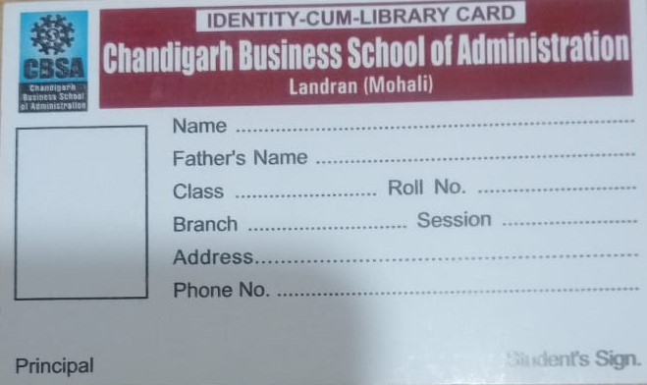
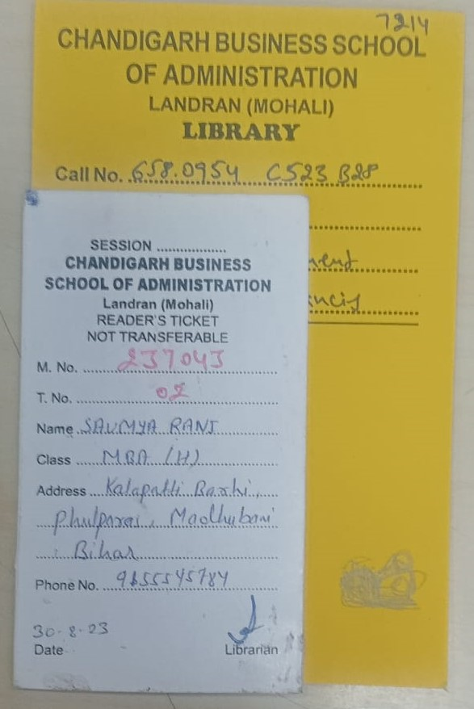
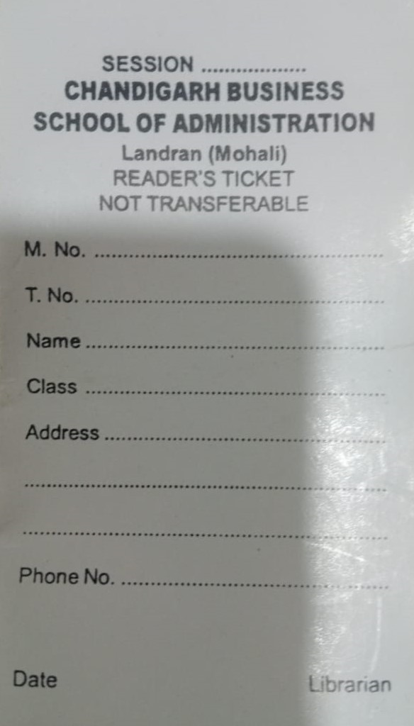
SPECIMEN : STUDENTS’ LIBRARY CARD AND TICKETS

Slide 53
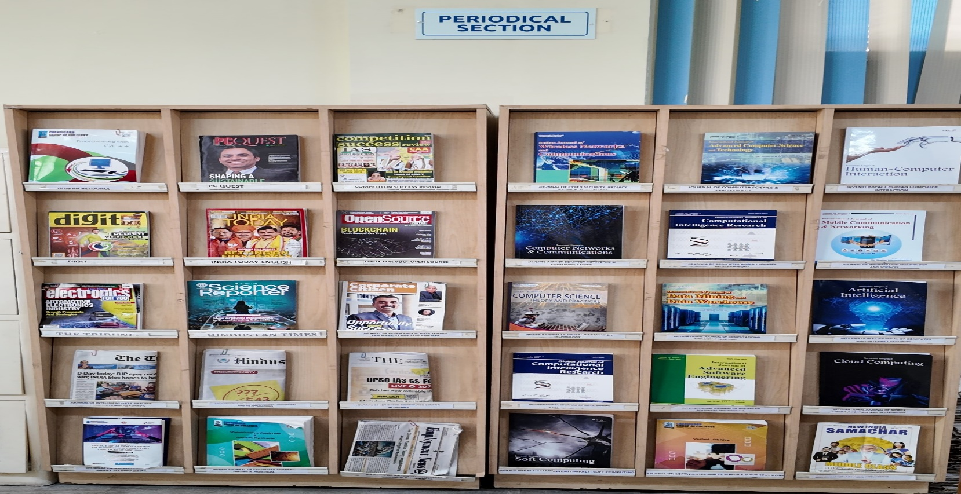
PERIODICAL SECTION
CBSA LIBRARY SUBSCRIBES 33 PRINT JOURNALS, 8 MAGAZINES , AND 5 NEWSPAPERS

Slide 54
LIST OF SUBSCRIBED PRINT JOURNALS- YEAR 2026
MANAGEMENT
1 | INTERNATIONAL JOURNAL OF MARKET RESEARCH AND MARKET TECHNOLOGY
2 | INTERNATIONAL JOURNAL OF BUSINESS ADMINISTRATION & MANAGEMENT
3 | INTERNATIONAL REVIEW OF BUSINESS AND FINANCE
4 | INTERNATIONAL JOURNAL OF CUSTOMER RELATION MANAGEMENT
5 | INTERNATIONAL JOURNAL OF HUMAN RESOURCE MANAGEMENT
6 | IUP JOURNAL OF BANK MANAGEMENT
7 | JOURNAL OF DIGITAL MARKETING
8 | IUP JOURNAL OF OPERATIONAL MANAGEMENT
9 | IUP JOURNAL OF ORGANIZATIONAL BEHAVIOR
10 | SCIENTXT INTERNATIONAL JOURNAL OF RECENT TRENDS IN DIGITAL MARKETING
11 | GLOBAL JOURNAL OF FINANCE AND MANAGEMENT
COMPUTER APPLICATION
12 | JOURNAL OF COMPUTER SCIENCE AND APPLICATIONS
13 | INTERNATIONAL JOURNAL OF ADVANCED COMPUTER SCIENCE AND TECHNOLOGY
14 | GLOBAL JOURNAL OF COMPUTATIONAL INTELLIGENCE RESEARCH
15 | JOURNALS OF INNOVATIONS IN DIGITAL MARKETING
16 | INDIAN JOURNAL OF COMPUTER SCIENCE: THEORY AND PRACTICAL
17 | JOURNAL OF BIG DATA TECHNOLOGY & BUSINESS ANALYTICS
18 | JOURNAL OF INNOVATIONS IN DATA SCIENCES & BIG DATA MANAGEMENT
19 | JOURNAL OF INTEGRATED MARKETING COMMUNICATION & DIGITAL MARKETING

Slide 55
20 | JOURNAL OF INTELLIGENT DATA ANALYSIS & COMPUTATIONLA STATISTICS
21 | JOURNAL OF DATA ENGG. & KNOWLEDGE DISCOVERY
22 | INVENTI IMPACT: SOFT COMPUTING
CYBER SECURITY
23 | JOURNAL OF CYBER SECURITY IN COMPUTER SYSTEM
24 | JOURNAL OF CYBER SECURITY, PRIVACY ISSUES AND CHALLENGES
25 | JOURNAL OF HACKING TECHNIQUES, DIGITAL CRIME PREVENTION & COMPUTER VIROLOGY
26 | JOURNAL OF CRYPTOGRAPHY & NETWORK SECURITY, DESIGN & CODES
27 | INTERNATIONAL JOURNAL OF CYBER SECURITY
ARTIFICIAL INTELLIGENCE & MACHINE LEARNING
28 | ICTACT JOURNAL OF ARTIFICIAL INTELLIGENCE & MACHINE LEARNING
29 | INVENTI IMPACT: ARTIFICIAL INTELLIGENCE
30 | RECENT TRENDS IN ARTIFICIAL INTELLIGENCE & ITS APPLICATIONS
31 | JOURNAL OF ARTIFICIAL INTELLIGENCE RESEARCH & ADVANCES
32 | RESEARCH & VIEW: MACHINE LEARNING & CLOUD COMPUTING
33 | JOURNAL OF FUZZY SETS & FUZZY LOGIC DESIGN

Slide 56
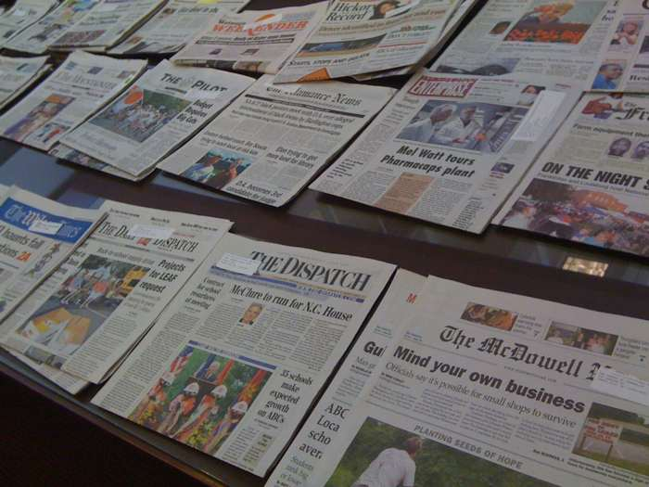

SR. NO. | NAME OF THE NEWSPAPERS
1 | THE TRIBUNE
2 | HINDUSTAN TIMES
3 | BUSINESS STANDARD
4 | THE ECONOMIC TIMES
5 | FINANCIAL EXPRESS

Slide 57
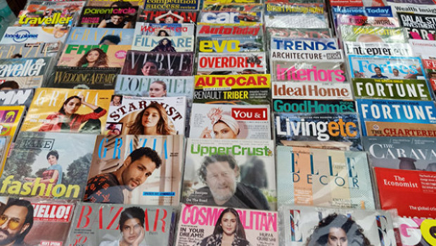
LIST OF MAGAZINES
SR. NO. | NAME OF THE MAGAZINES
1 | BUSINESS TODAY
2 | BUSINESS WORLD
3 | COMPETION SUCCESS REVIEW
4 | PRATIYOGITA DARPAN
5 | INDIA TODAY
6 | EMPLOYEMENT NEWS
7 | PC QUEST
8 | THE WEEK

Slide 58
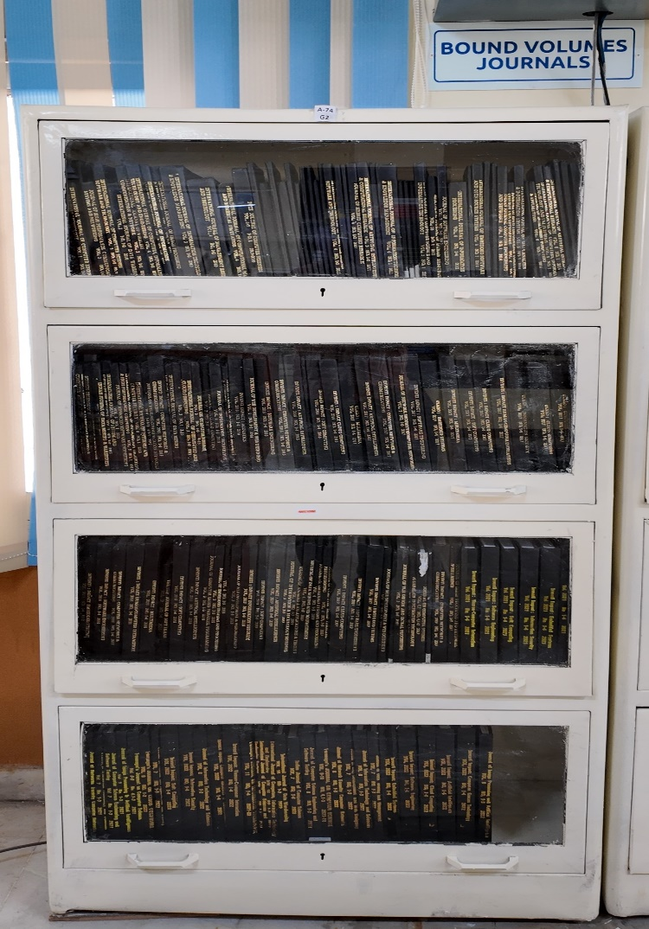
BOUND VOLUMES SECTION
JOURNALS till 2024

Slide 59
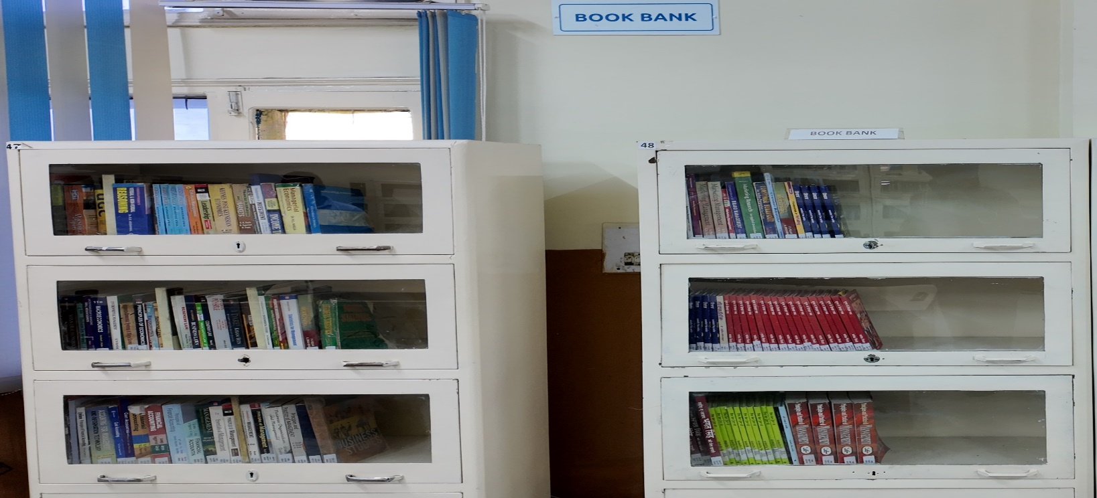
BOOK BANK SECTION

Slide 60
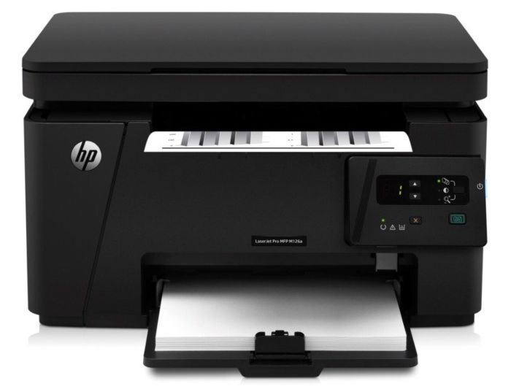
REPROGRAPHY FACILITY
LIBRARY FACILITATES ITS USERS BY PROVIDING REPROGRAPHIC SERVICE FOR GETTING THE REQUIRED MATERIAL PHOTOCOPIED. THE LIBRARY ALSO HAS SCANNING FACILITY AVAILABLE WITHIN THE LIBRARY PREMISES.

Slide 61
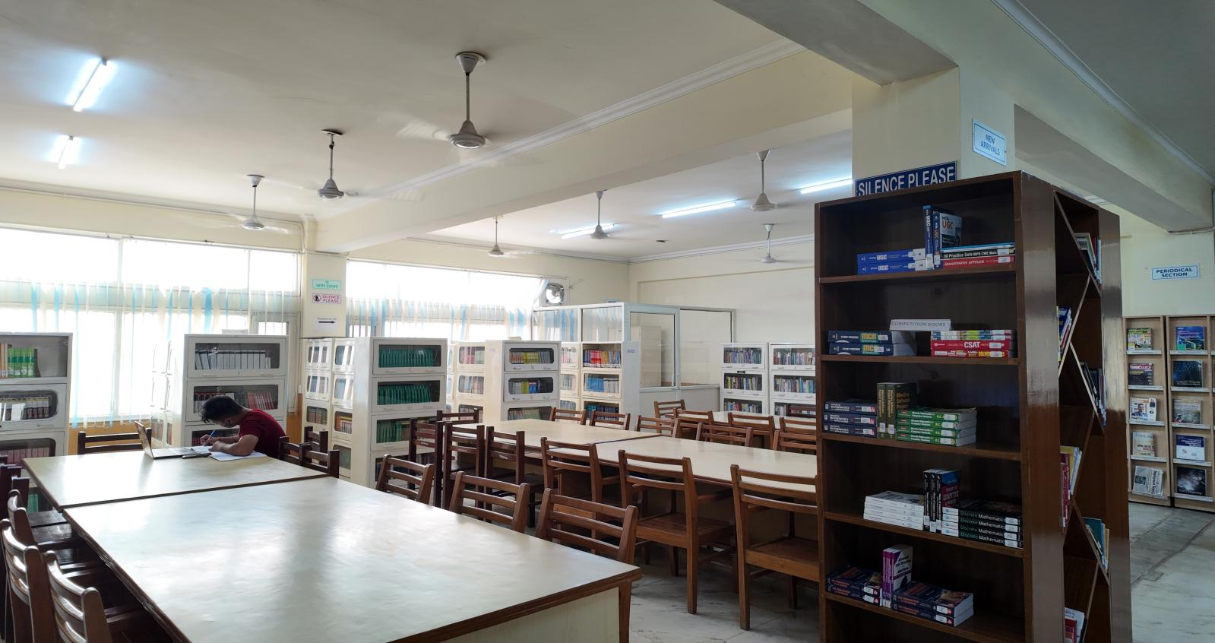
DISPLAY OF ENCYCLOPEDIA/ DICTIONARIES

Slide 62
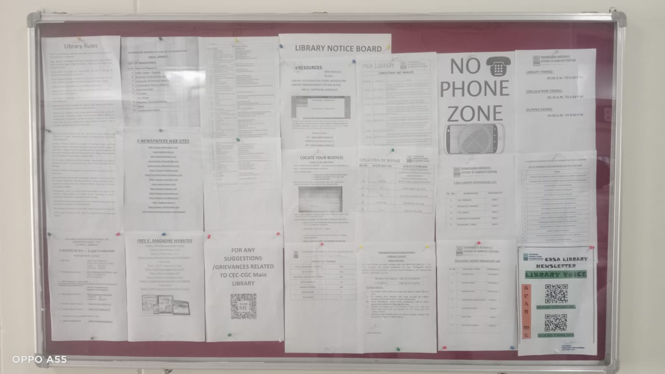
LIBRARY NOTICE BOARD

Slide 63
STACK AREA

Slide 64
CBSA - CGC
Library Rules
All students/users must observe total silence in the library and its environs at all times
All users/students are required to scan their College/Library ID Cards while entering the library. No one will be allowed to enter the Library without ID Card.
All students must present their Library ID Cards before borrowing any library material.

Slide 65
Library Rules CONTD.
In case of loss of ID and Reader’s Tickets, the duplicate ID card with DDR will be provided against Rs. 100/- and Readers’ Tickets against Rs.20/- each.
In case any book is lost or damaged by the borrower, he/she shall replace the latest issue of the book or set of books if one volume of the set is lost, or shall pay twice the cost of the book, within a period of 15 days, with delay fine if any.
Personal Books, Bags/ belongings, eatables, and mobile phone use are not allowed inside the library. A fine of Rs.100/- may be charged from the defaulters.

Slide 66
Library Rules CONTD.
The students/users are required to maintain discipline and silence within the library premises. In case of indiscipline, the Library Membership will be cancelled.
The students/users cannot take any book, magazine, or newspaper, outside the library without permission.
The Circulation Timing will strictly be between 9:30 AM to 4:00 PM without any break, on all working days.
The students will be issued 3 books against 3 Reader’s Tickets at a time, for a period of 21 days. The books in demand will be issued for 7 days.
All students have to return all the library books issued against their names before the start of the new semester

Slide 67
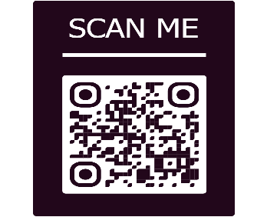
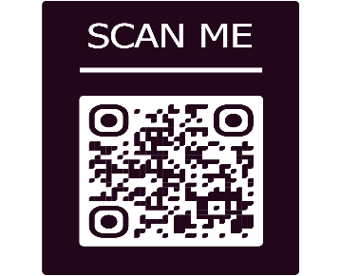
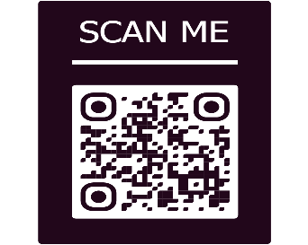
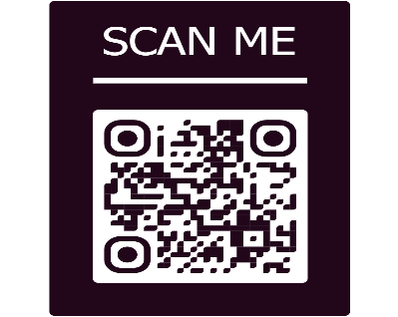
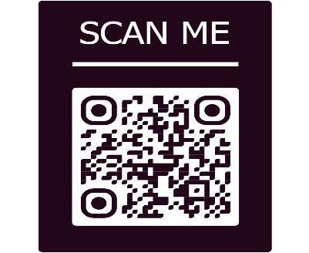
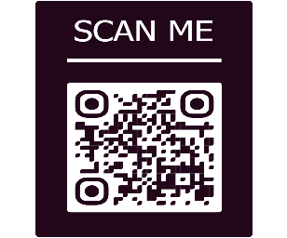
CBSA LIBRARY NEWSLETTERS
ISSUE NO. 1
OCTOBER 2023
. 1
OCTOBER 2023
ISSUE NO. 2
APRIL 2024
024
ISSUE NO. 3
August 2024
ISSUE NO. 4
MARCH 2025
ISSUE NO. 5
SEPTEMBER 2025
ISSUE NO. 6
APRIL 2026

Slide 68
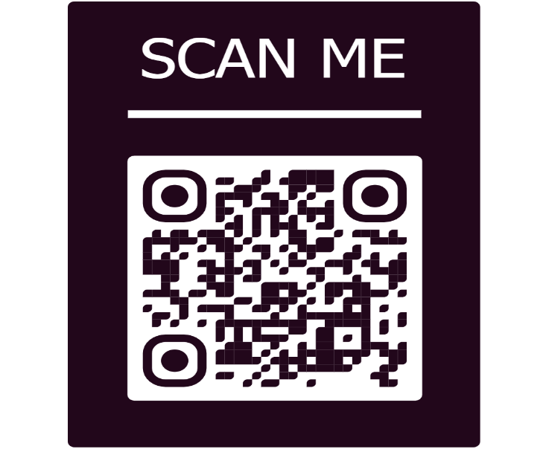
FOR ANY QUERY / SUGGESTION CONTACT :
Renu Oberoi
Chief Librarian
Chandigarh Business School of Administration, Landran
0172-3984229
8872014309
chief.librarian@cgc.edu.in

Slide 69
Ready to HELP YOU
THANK YOU

